Slide 1

Notes:
Value proposition

Slide 2
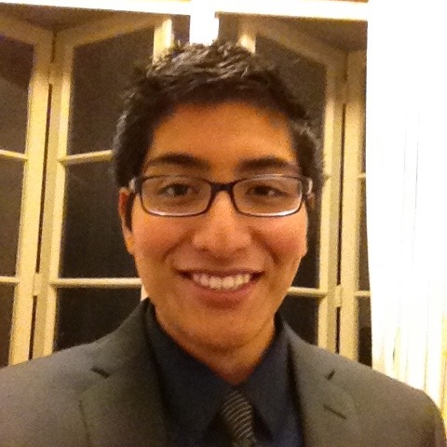
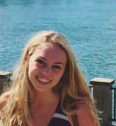
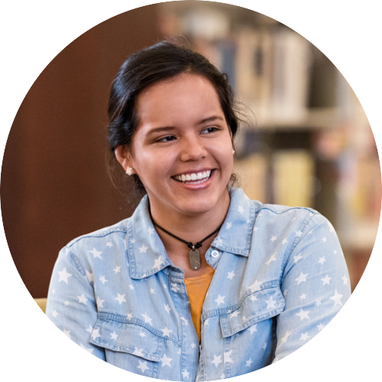
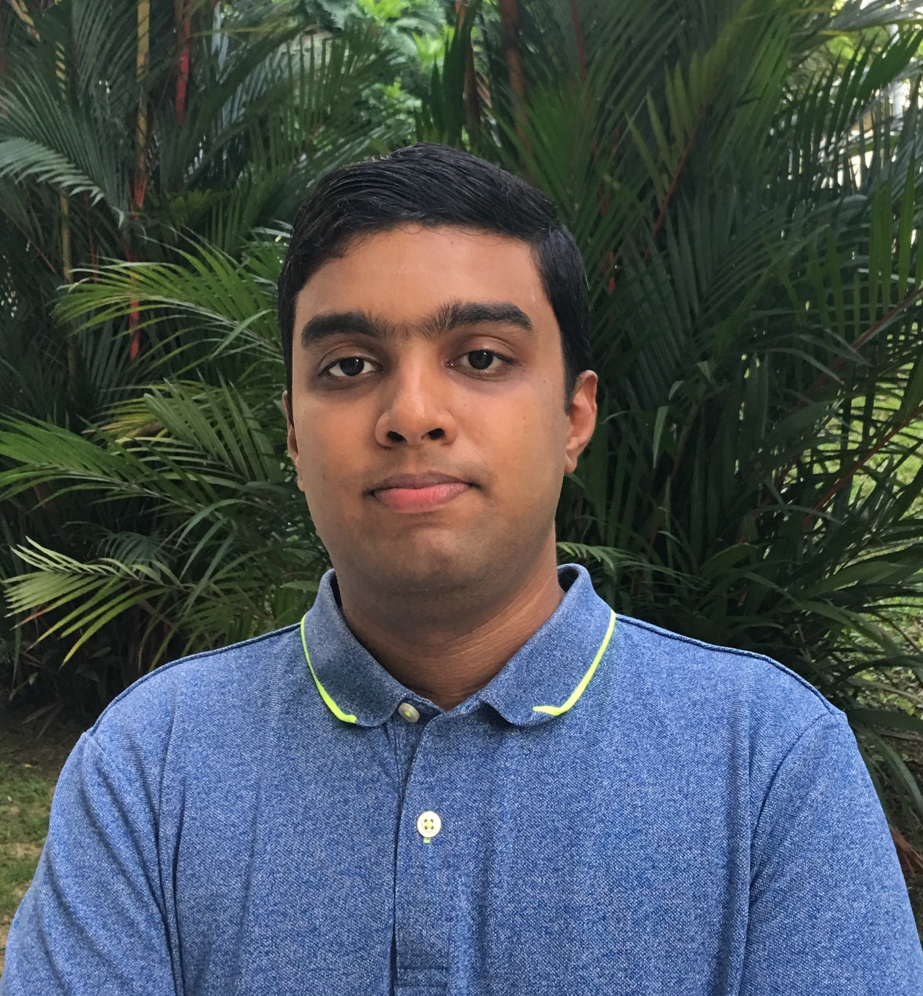
The Team
Michael
Cruz Doshi
Bronwyn
Campbell Early
Alejandrina
Gonzalez Reyes
Senthilnathan Viswanathan

Slide 3
The Problem
FOOD
RESTRICTED EATERS
People with diets limited by food allergies, sensitivities, and other medical, religious, or moral reasons
Notes:
Socializing over meals, or merely finding a meal away from home, can be a challenge for people with dietary restrictions. These people are extremely conscious of where and what they eat, and they will do almost anything to avoid eating in social and uncontrolled settings. To meet this challenge, some people eat a full meal before going out, others conveniently arrive after everyone has eaten, and some people avoid these social settings and stop eating out with friends. But they shouldn’t have to choose between social eating and safe eating. That’s where meetchewthere comes in.

Slide 4
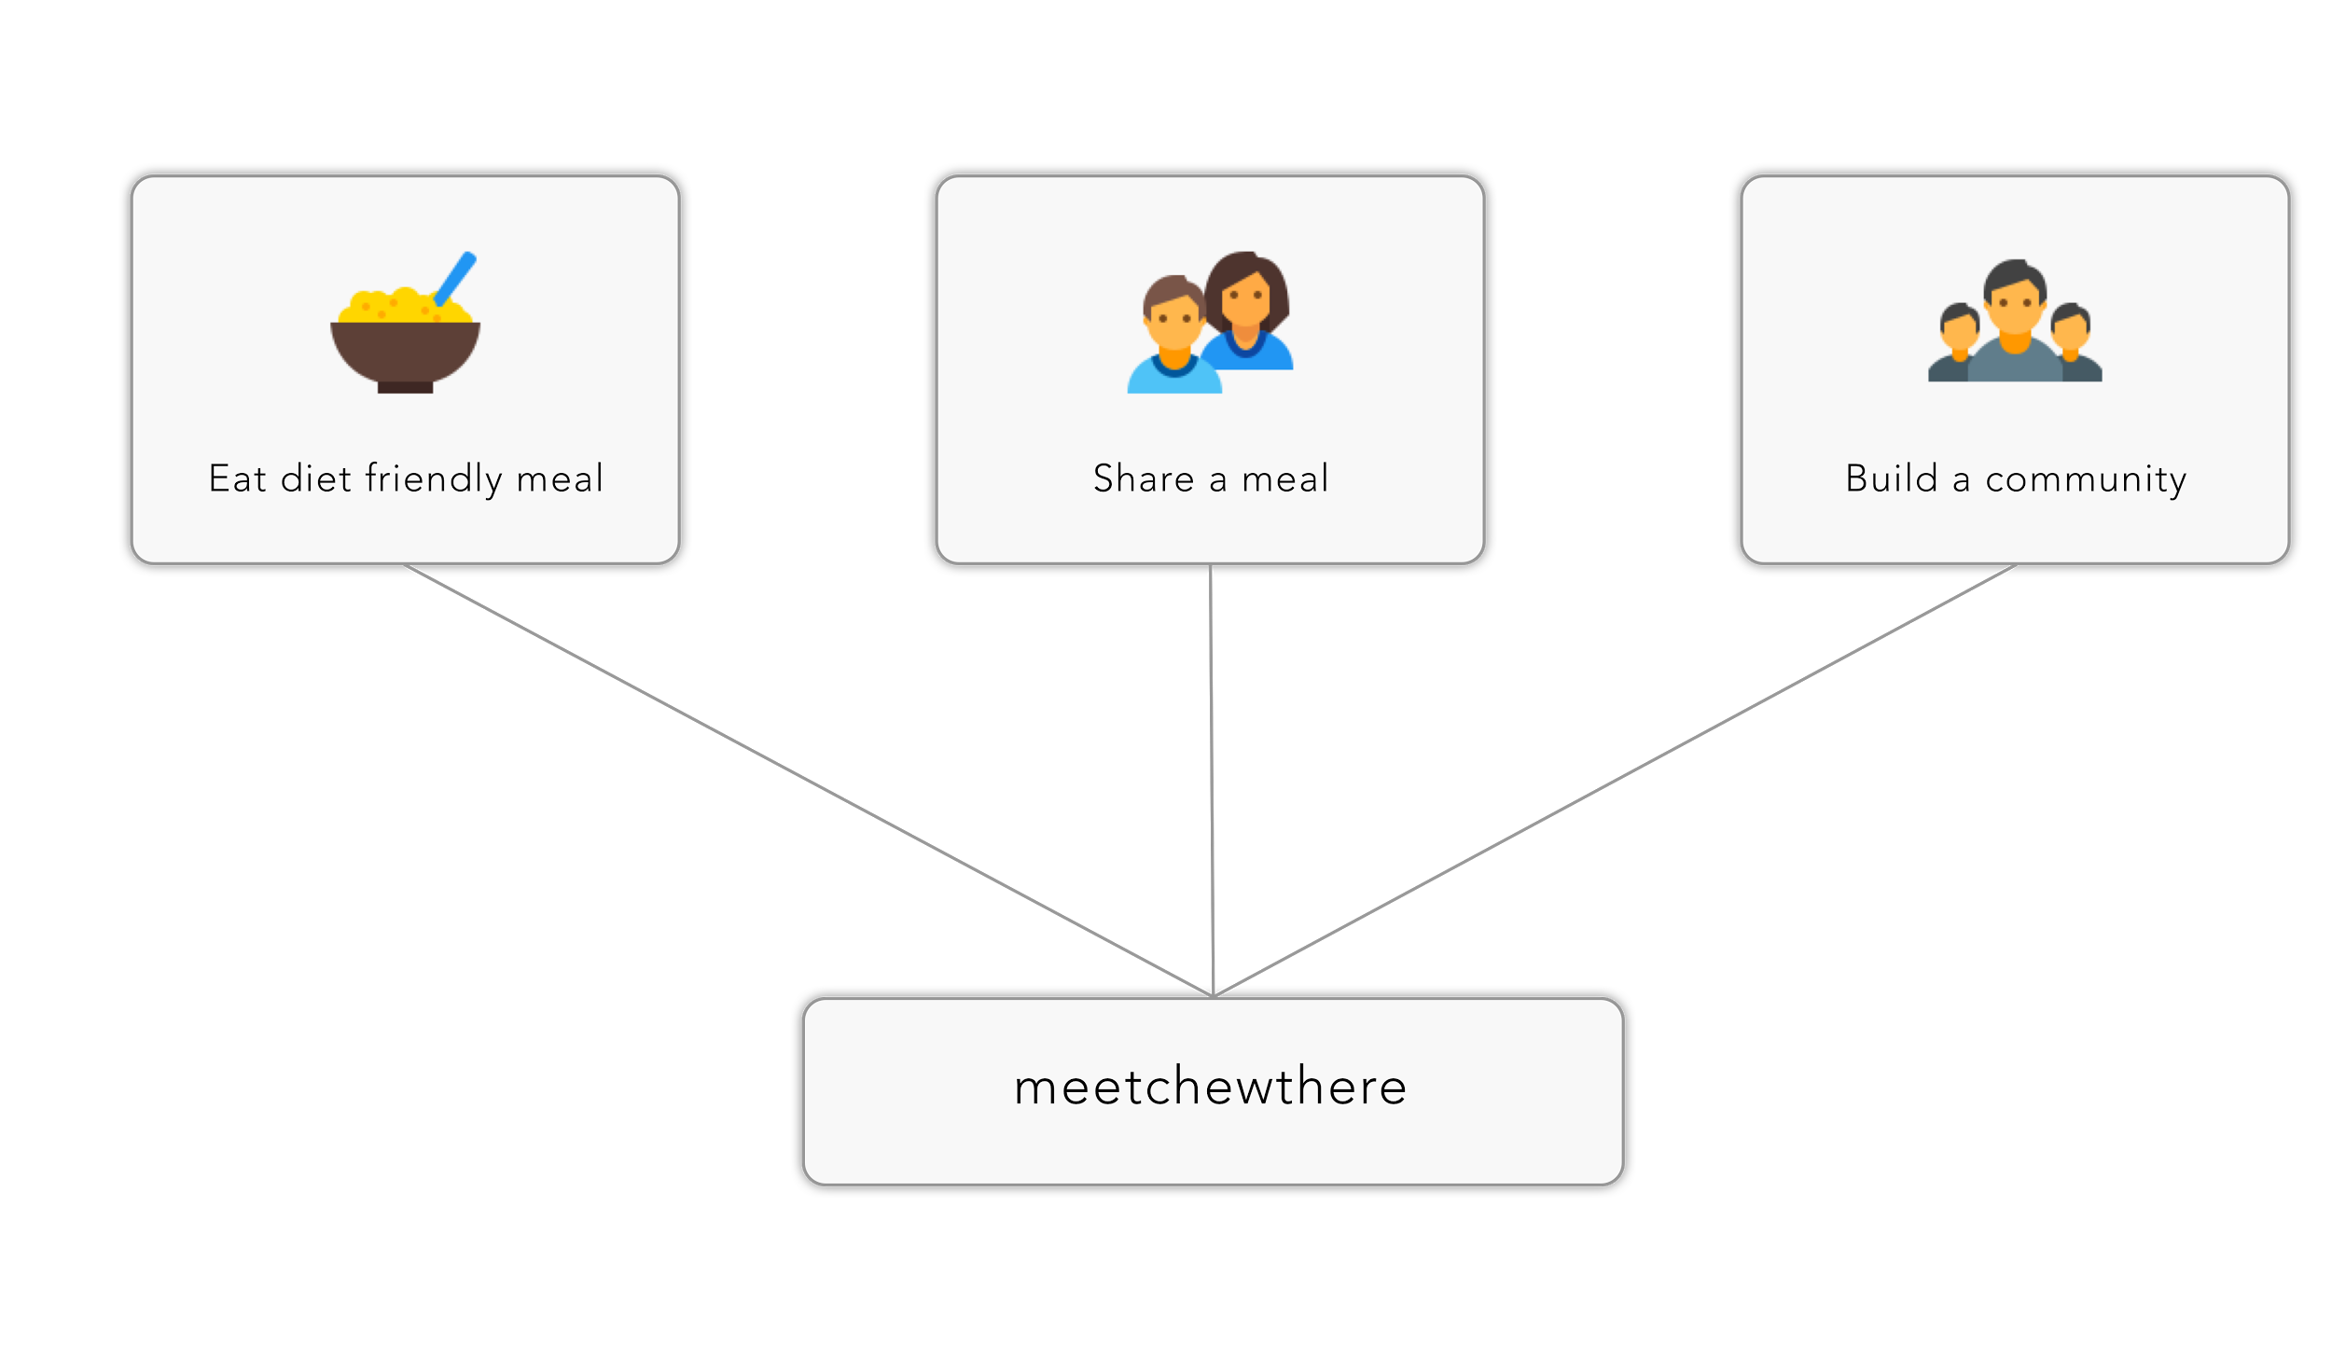
Our Solution
Notes:
Our aim is to redefine social eating for these groups of people. We aim to provide a safe space to find diet friendly restaurants and events to attend, as well as an opportunity to create and host their own food centered events. These events will help build trusted communities of geographically proximate people with common restrictions to share their experiences.

Slide 5
Talking Points
Concept Video
Design Evolution
Walkthrough
Future Work
Notes:
During our interactions with several participants, we found dietary restrictions to be one of the most ignored problems of the food industry. We them aimed to answer the question “How might we make eating not be the most stressful part of someone’s day?”. With this in mind, we started experience prototypes, concept sketches, low-fi paper prototypes, medium-fi and high-fi prototypes. At each stage of the process, we improved upon our product based on feedback from our target audience as well as our peers in our studio through heuristic evaluation. At the end of this presentation, I will show you a demo of our product as well as ways to improve it.

Slide 6
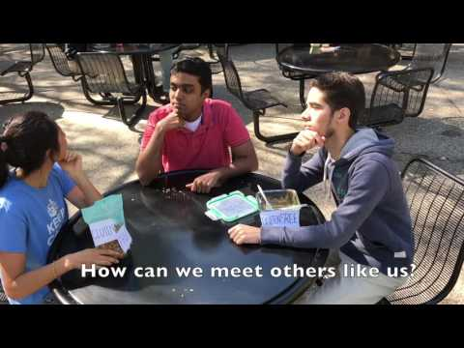
Concept Video

Slide 7

Design Evolution
The stages between needfinding
and building a hi-fi prototype

Slide 8
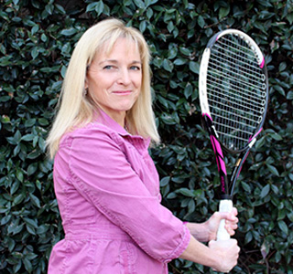
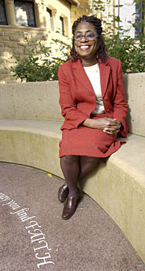

Needfinding
Davis - the overbooked associate
Dora - the master planner
Elaine - the routined eater
Ellie - the health nut
Evan - the olympic athlete
Jessica - the reluctant chef
Joel - the mood eater
Jonathan - the average joe
Justina - the new mom
Richard - the young professional
250 10
Minutes People
4 1
Locations Commonality
Notes:
During our needfinding process, we met 10 people from different walks of life, ranging from pregnant mothers to athletes who participated in the 2016 olympics.

Slide 9




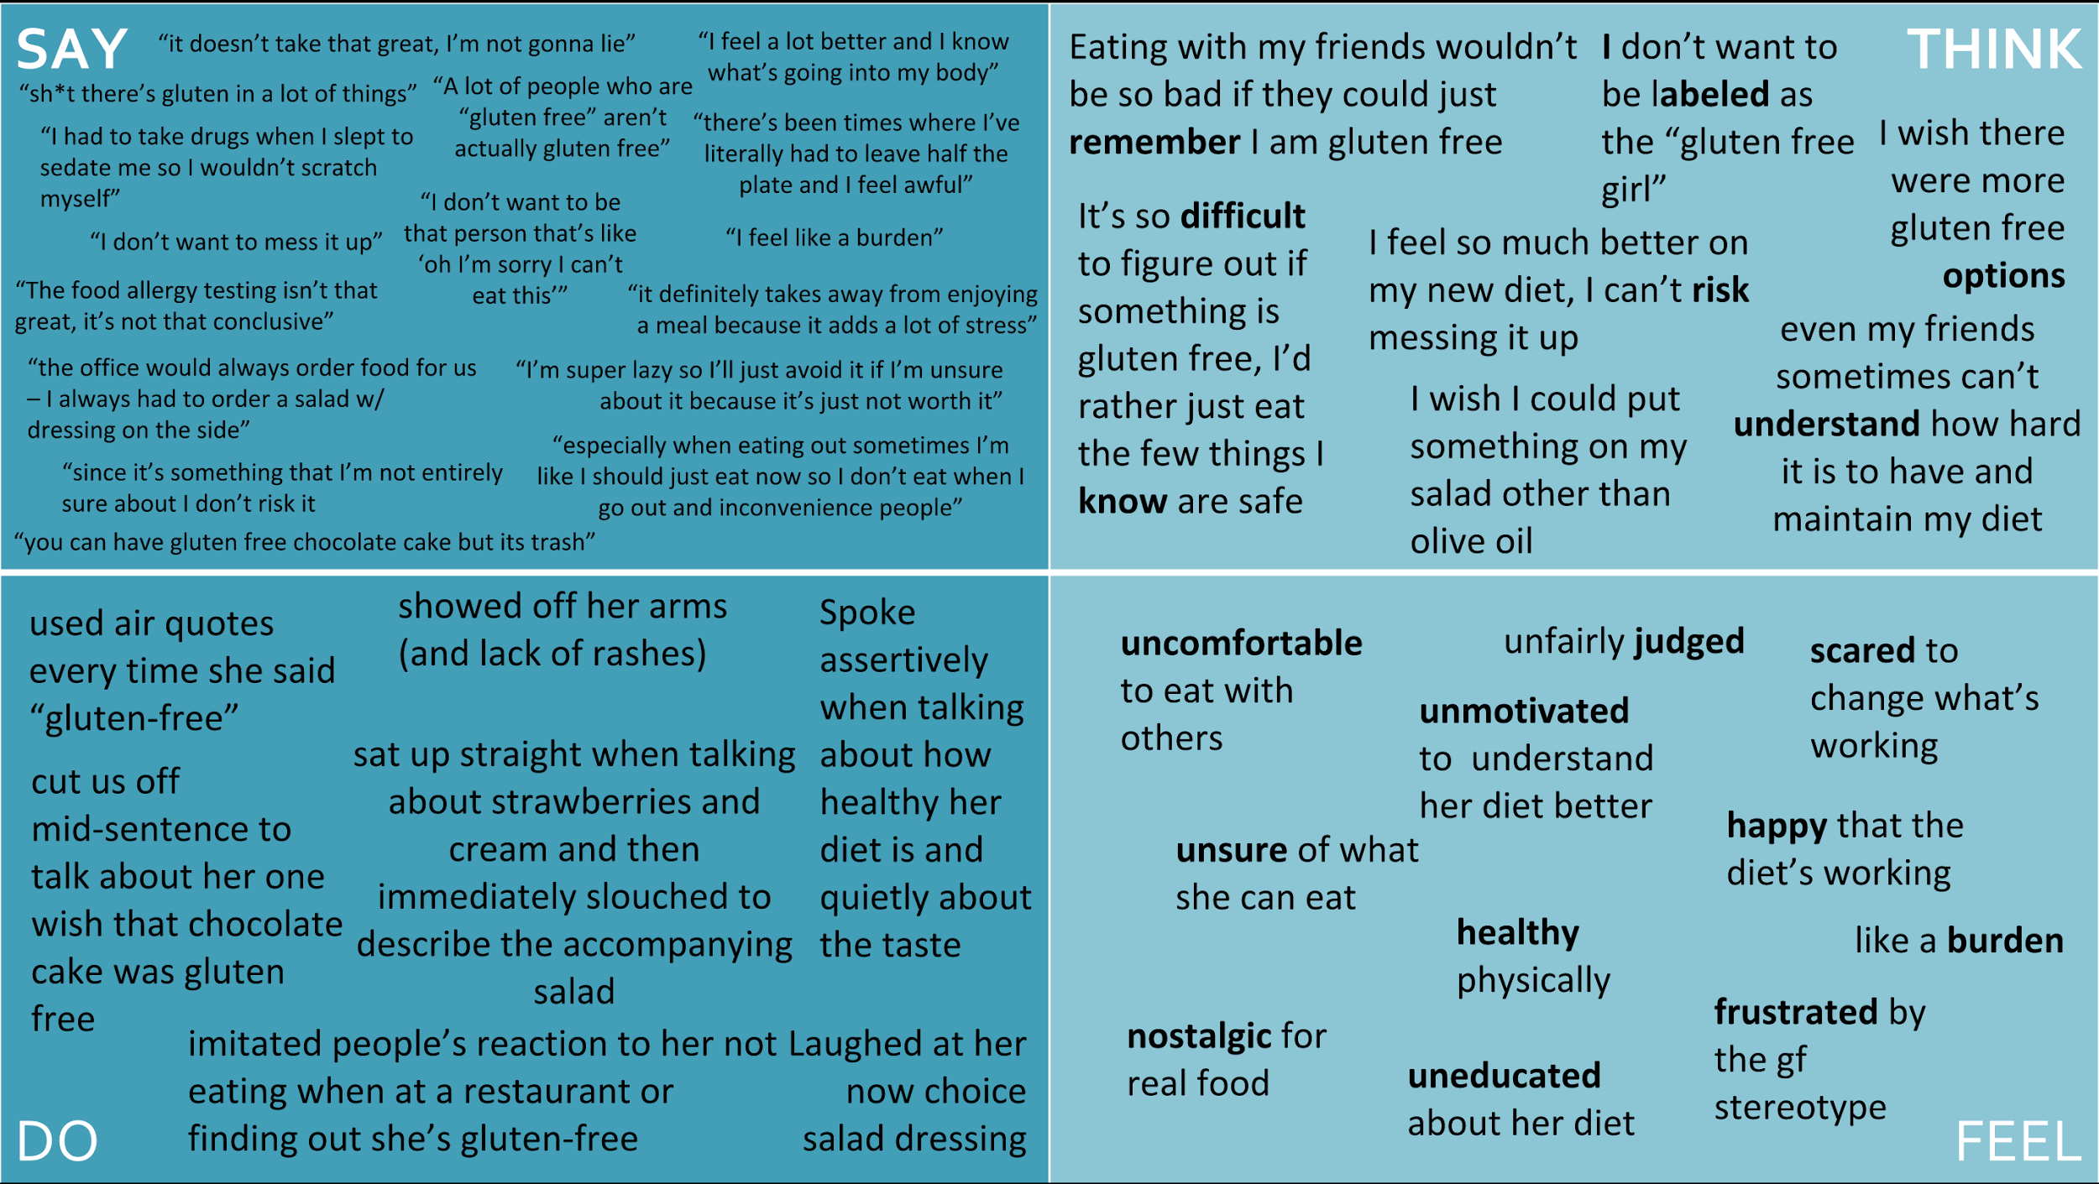

POVs and Experience Prototypes
We met ….
We were amazed to realize
It would be game changing ….
Tasting Tour
On-Demand
Chefs
Group
Dieting
Notes:
We learnt the participants problems, from what they said, thought, did and felt during the interview process. We then went on to work on 3 different experience prototypes.

Slide 10
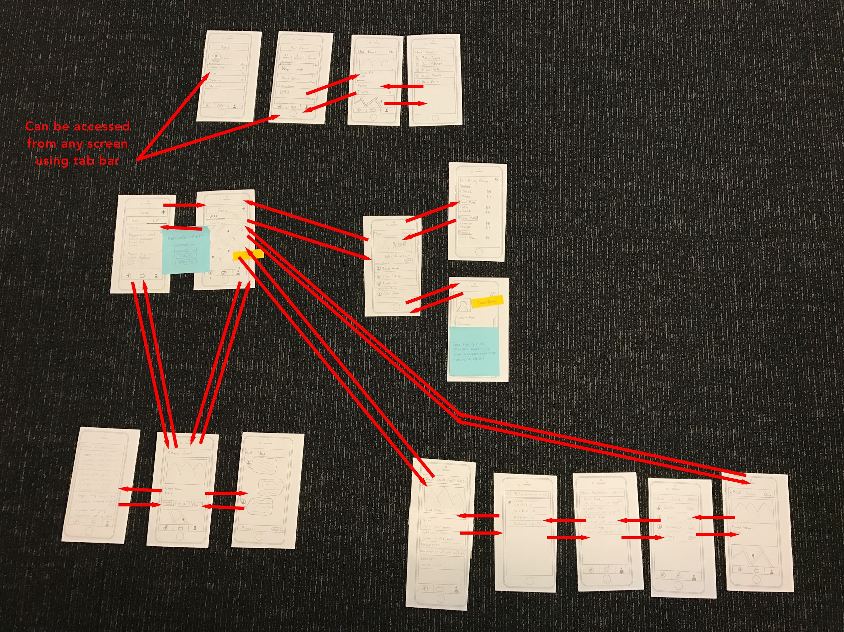
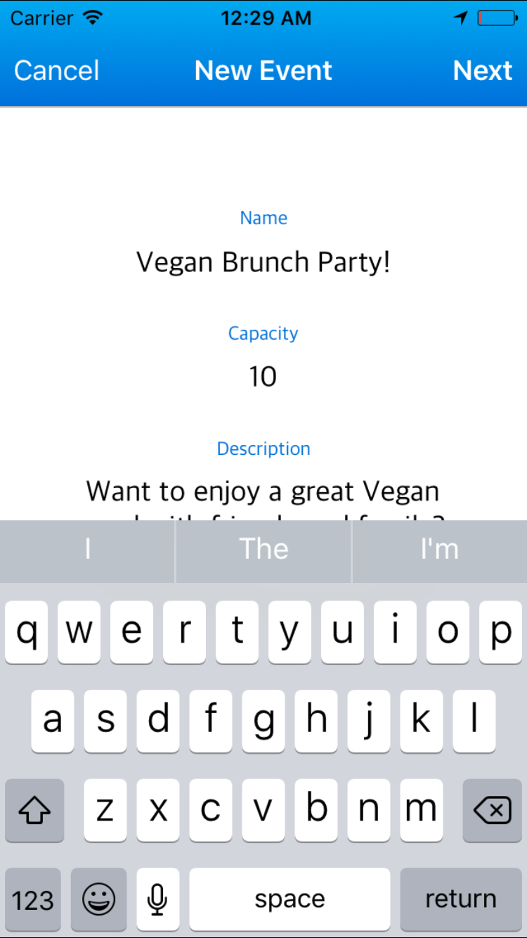
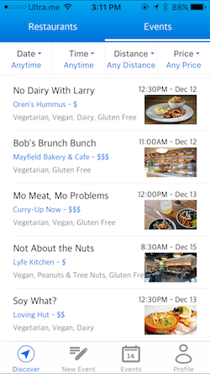
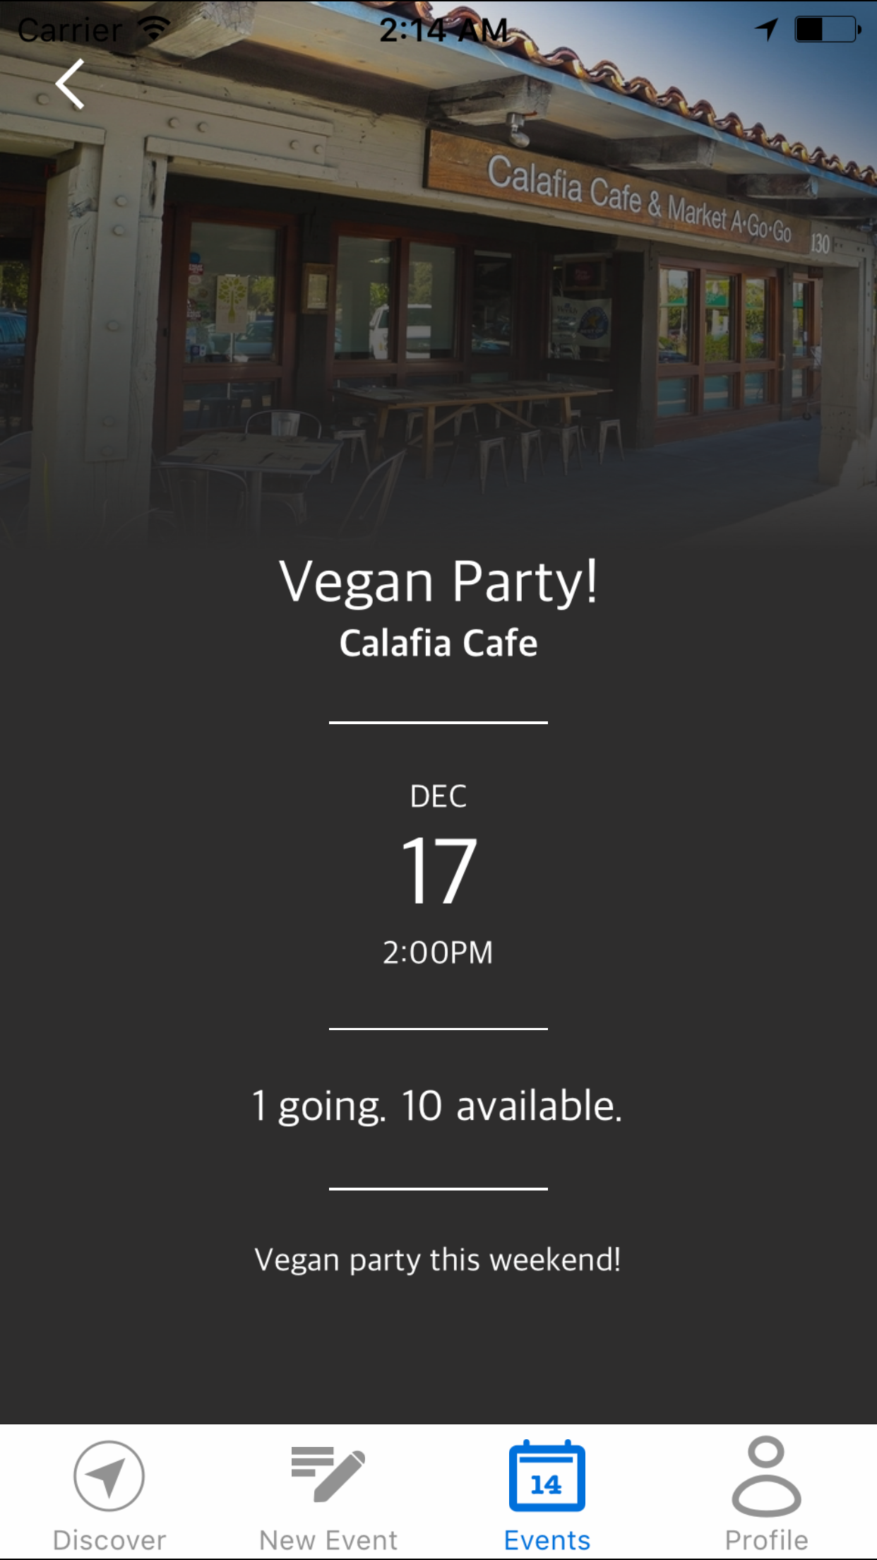
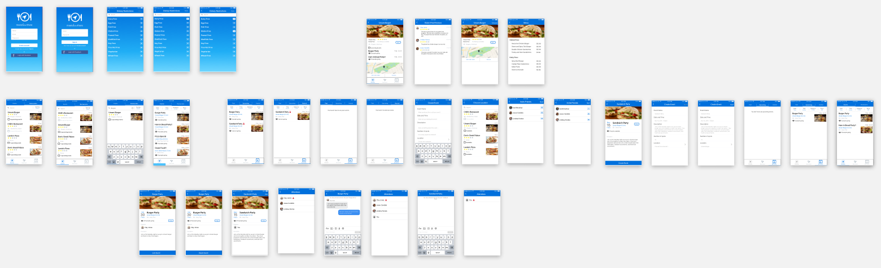
Low, Medium and Hi-Fi Prototypes
Low-Fi
Medium-Fi
Hi-Fi
Notes:
Here’s a look of how we started from paper sketches, then moved on to an app prototyped using sketch and marvel and finally went on to build an iOS app for our idea.

Slide 11
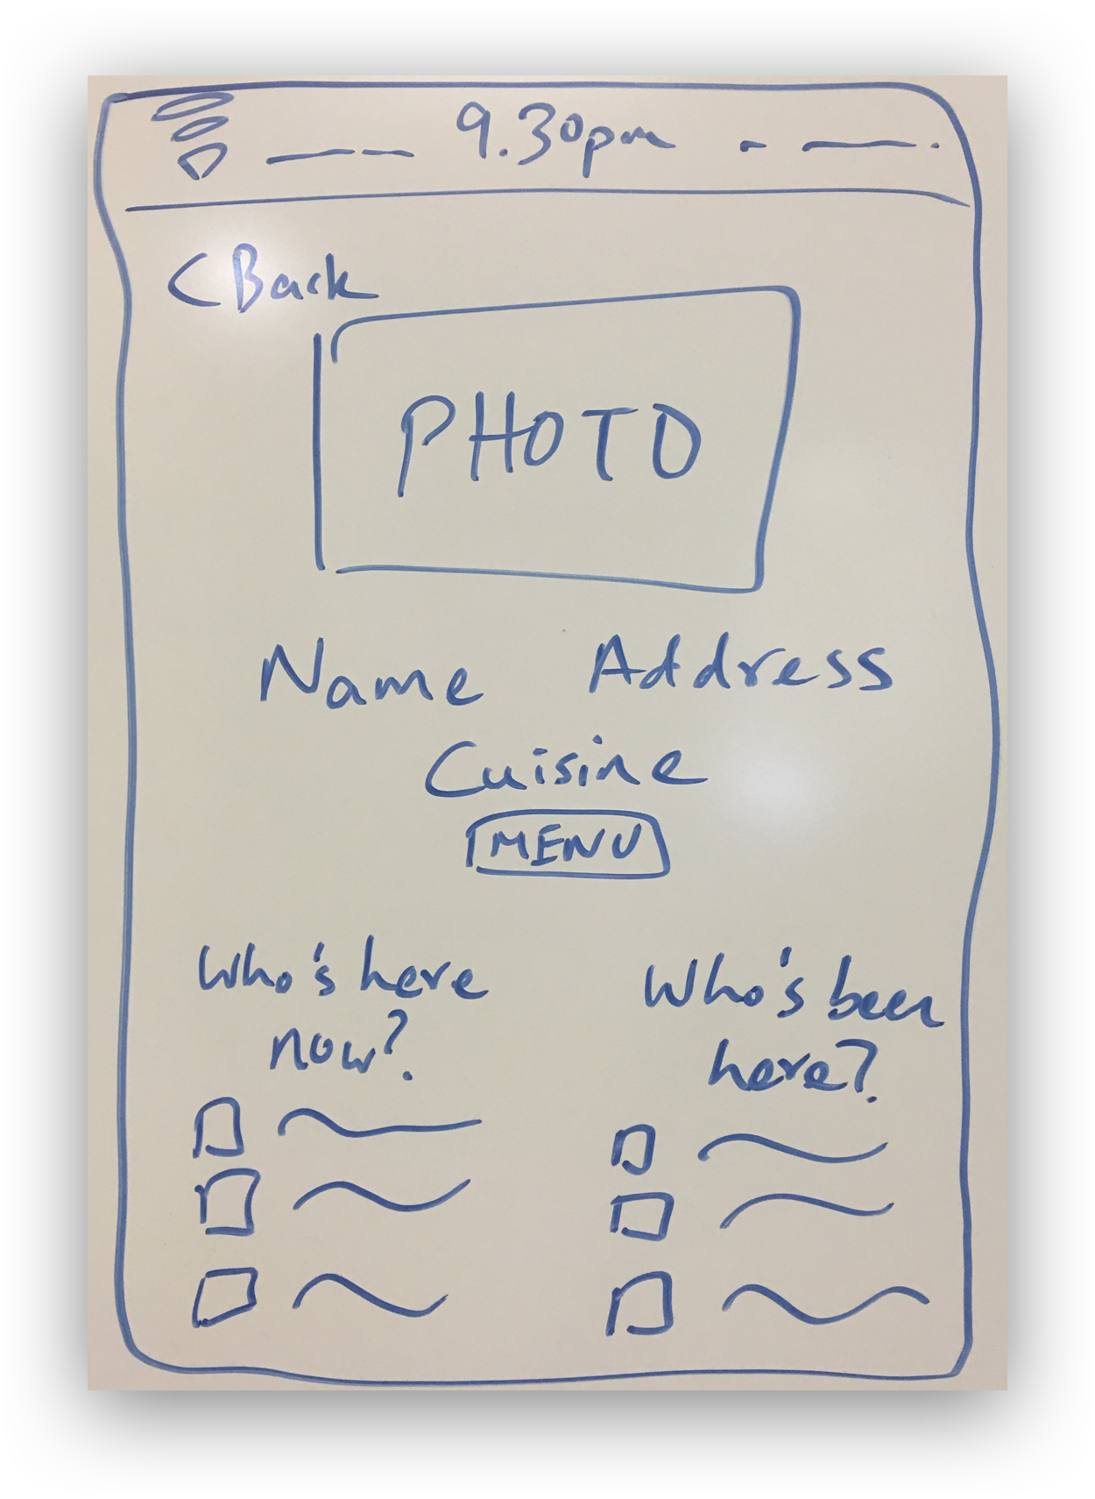
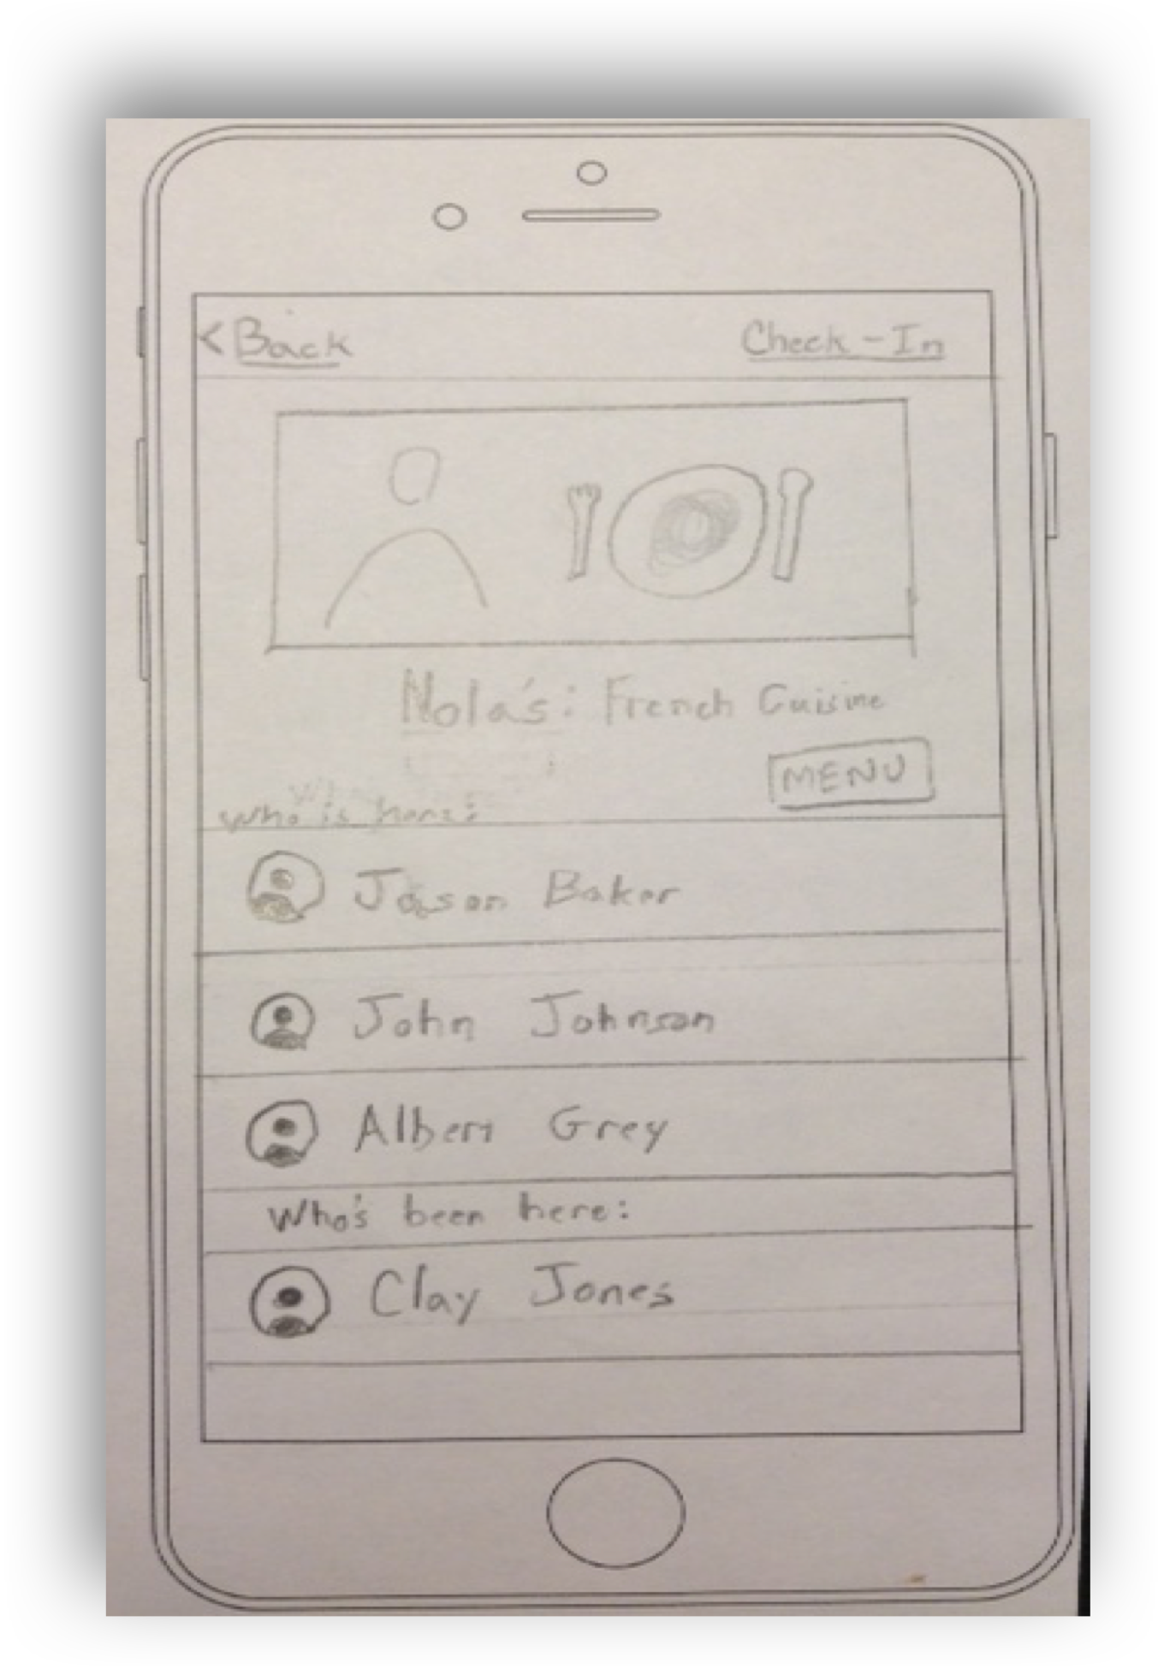
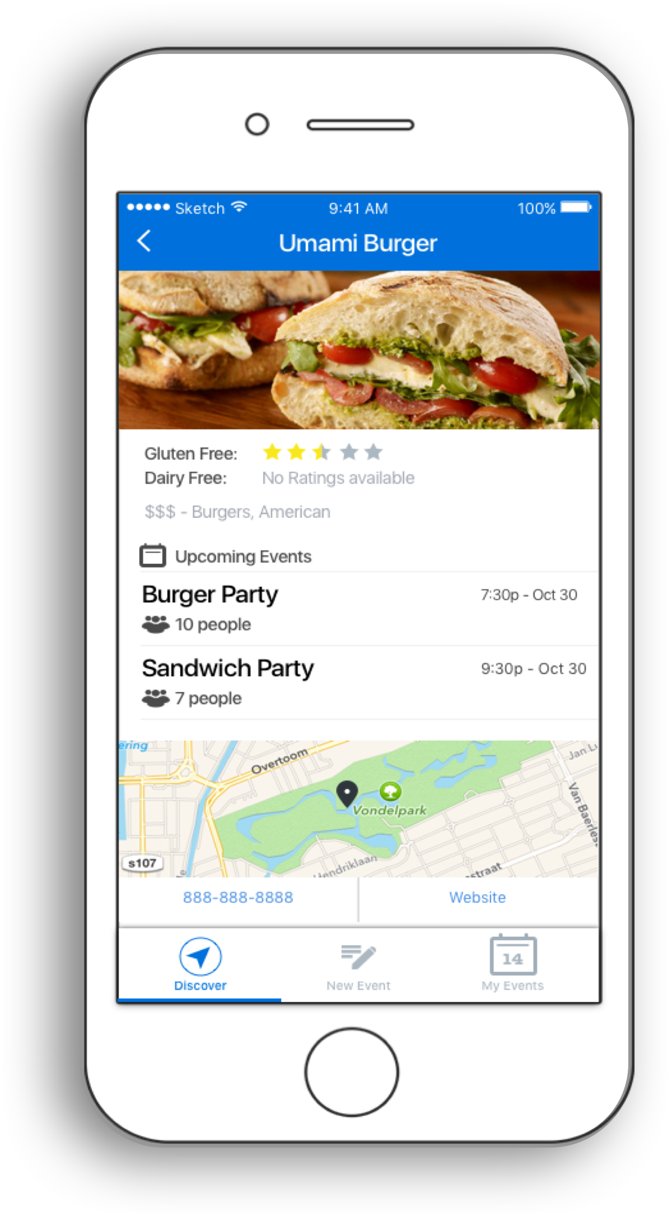
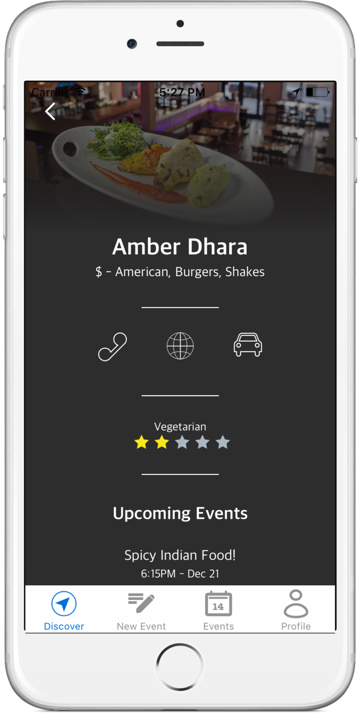
The changes from whiteboard to an app …...
Concept Sketch
Low-Fi
Medium-Fi
Hi-Fi
Notes:
Mention about user testing with low fi prototype and heuristic evaluation
6b - Explain reasoning/evidence behind key design changes (i.e., eval technique & what it found at each stage)

Slide 12
Tasks,
Walkthroughs
&
Demos

Slide 13
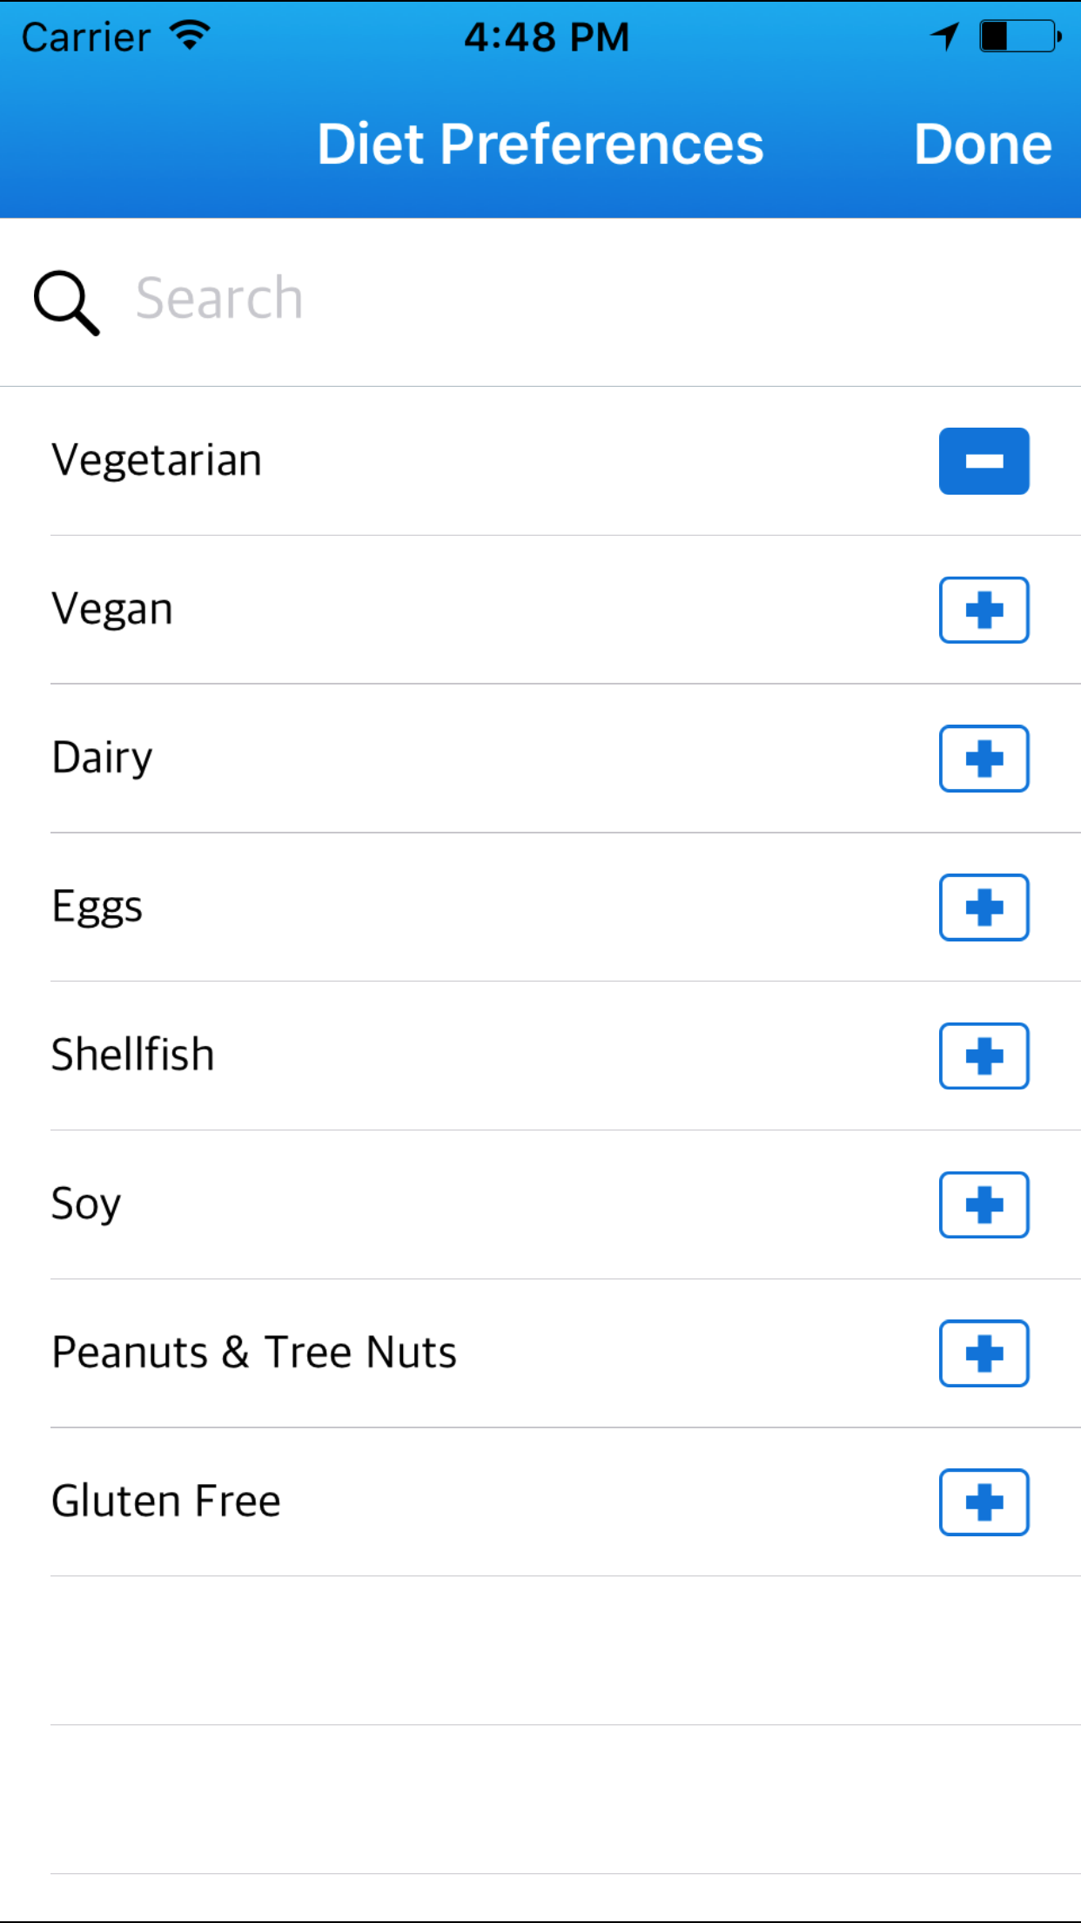
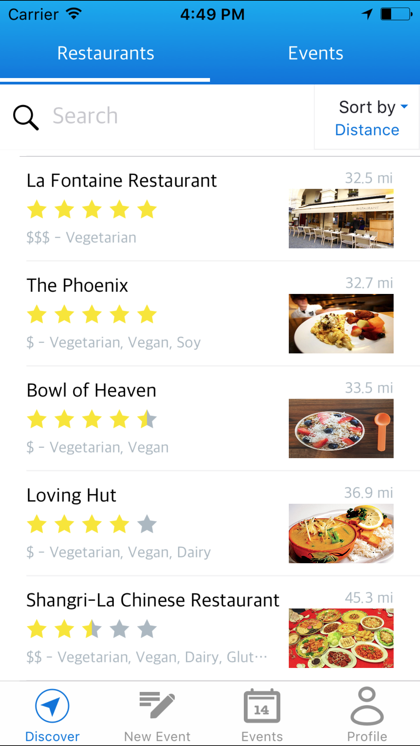
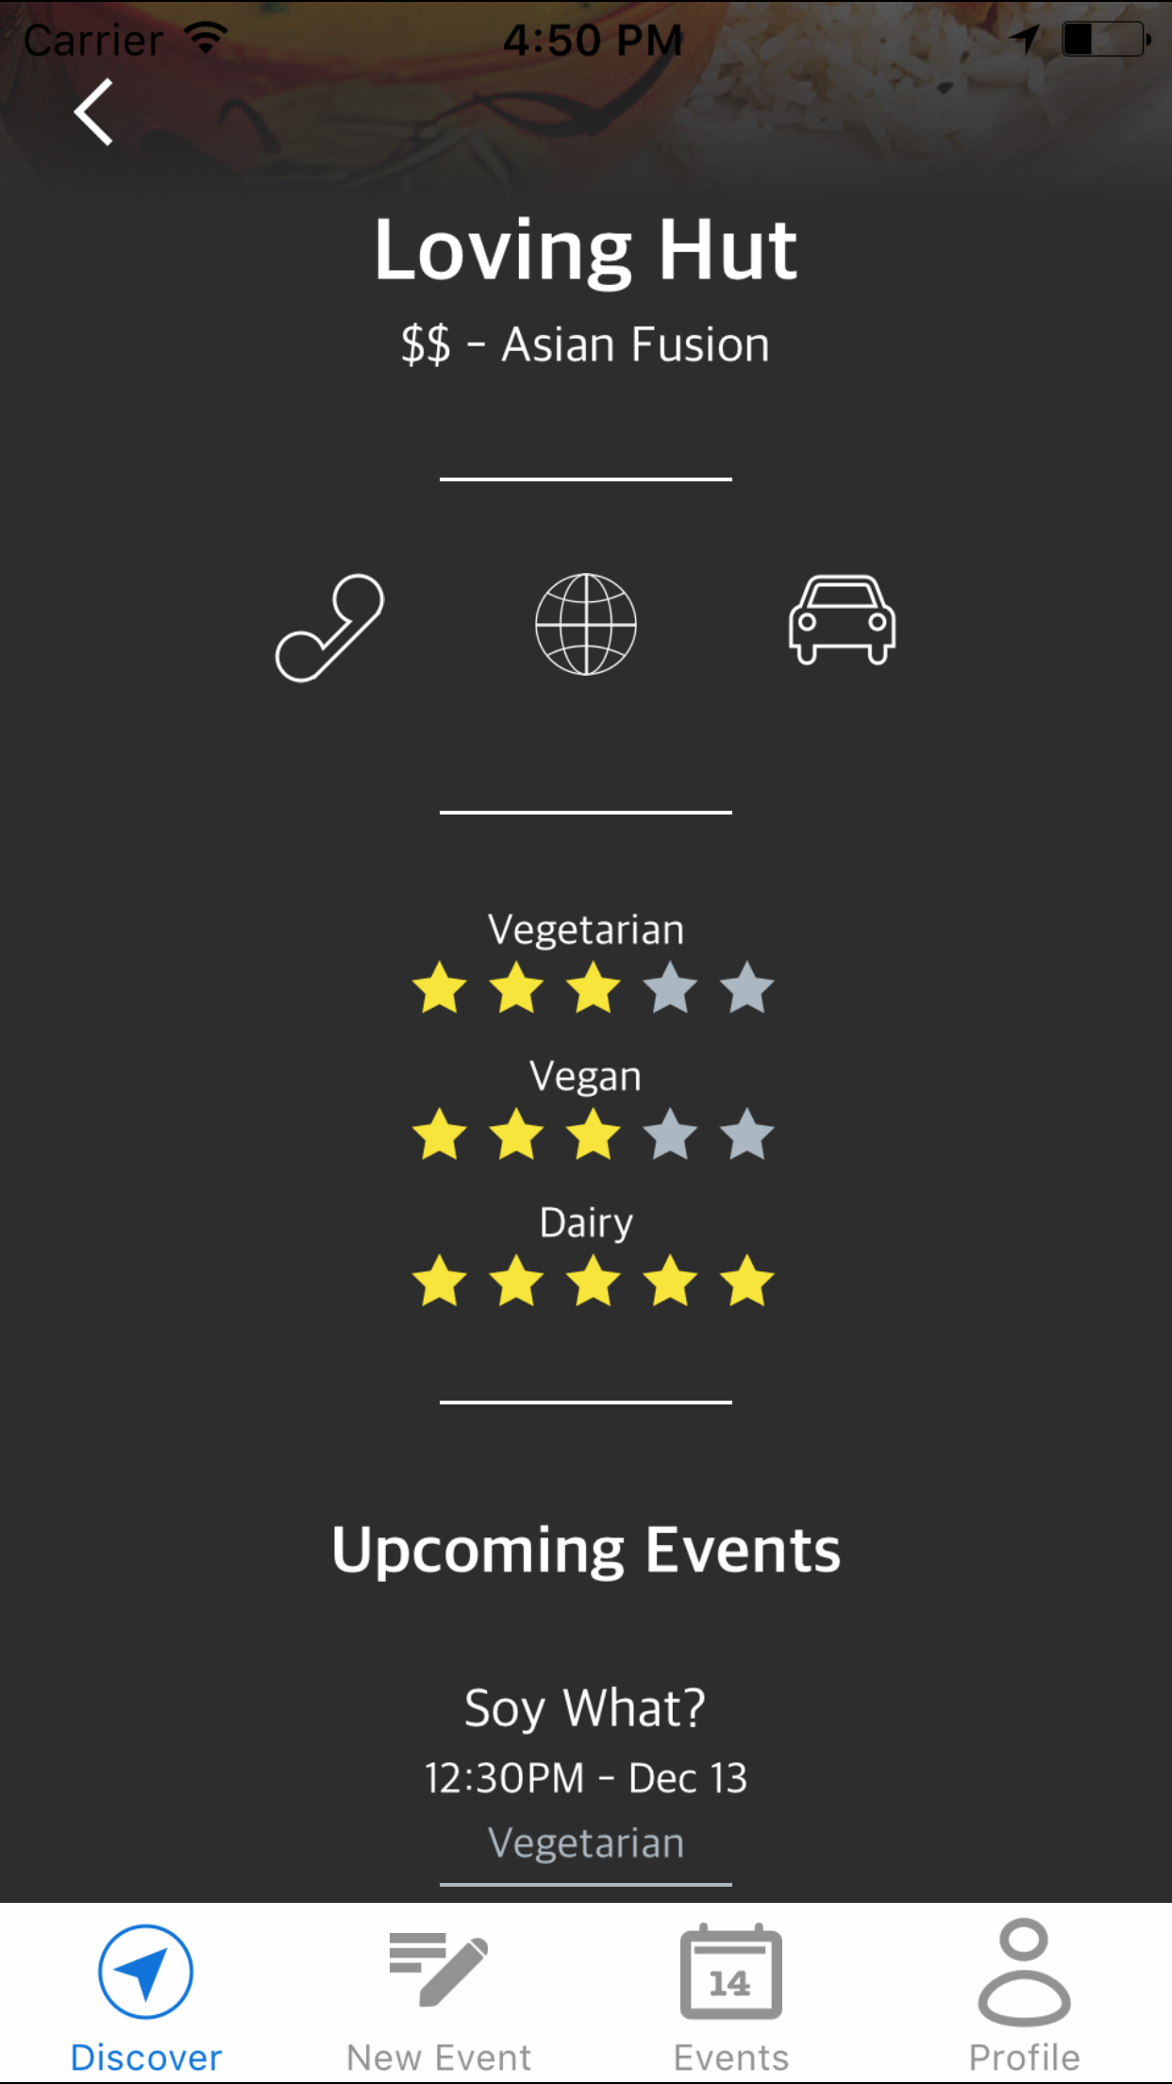
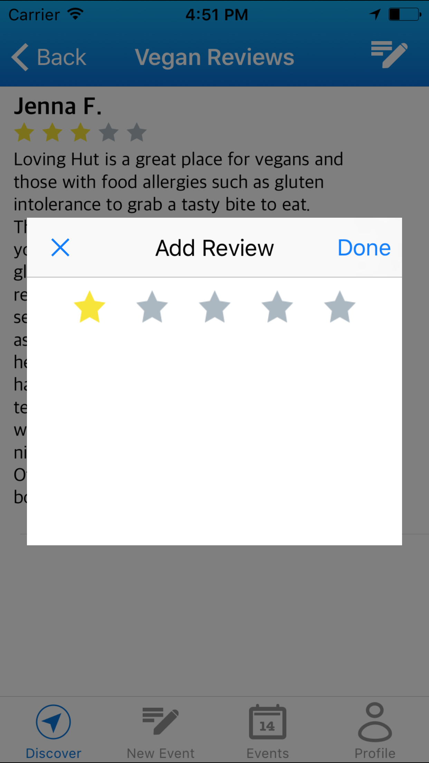
Task 1: Find Food
Locate restaurants that fit your dietary restrictions!
Notes:
Selecting a restaurant to eat is a simple task for most people, but finding a safe place to eat can seem like an difficult task for people with restricted diets. We want our users to experience restaurant selection like the rest of us ─ a simple, worry-free task.
meetchewthere maintains curated lists of nearby restaurants that cater to specific dietary needs .
List view with ratings and dietary restrictions tags
Sort
Search using keywords
restriction specific ratings and reviews from other meetchewthere users. These reviews eliminating any uncertainty about the menu and the safety of the selected restaurant!
Add your own reviews

Slide 14
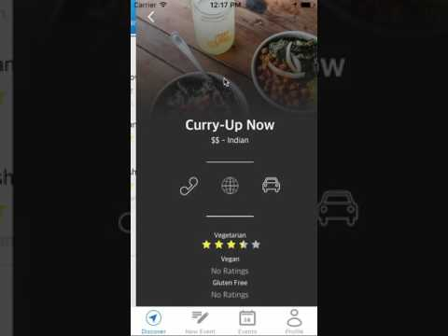
Task 1 Demo

Slide 15
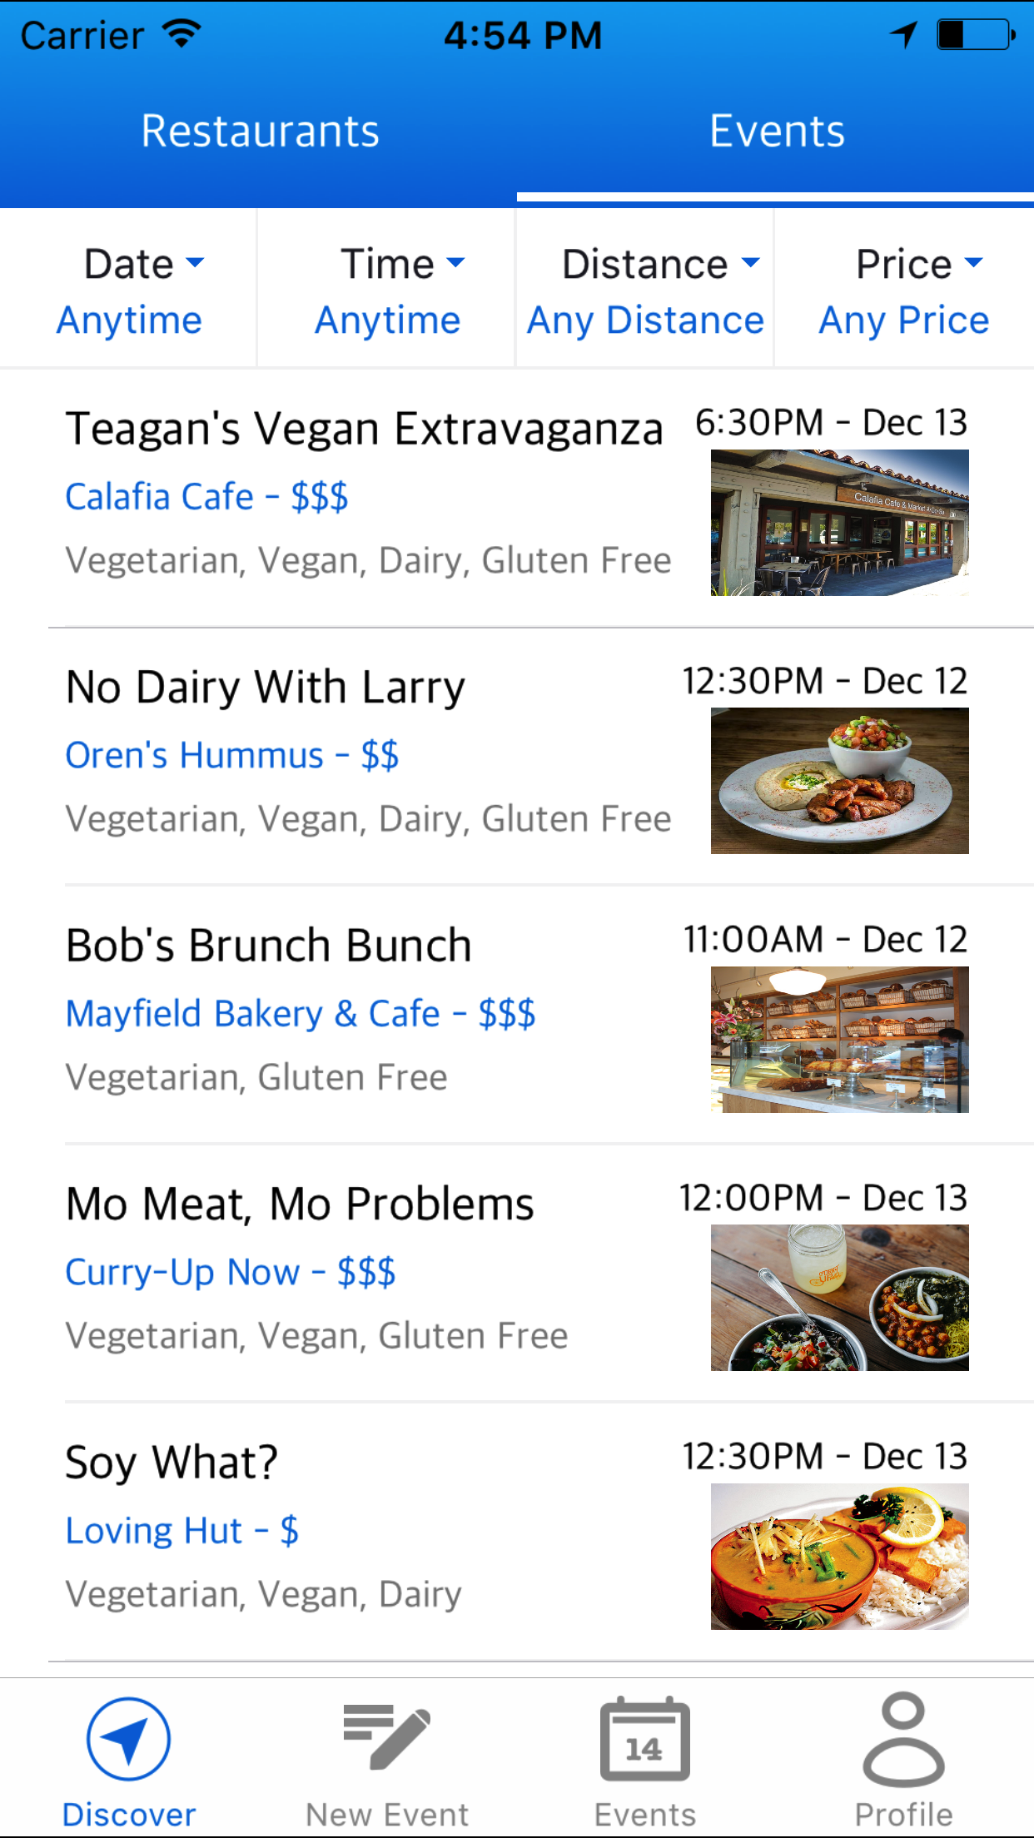
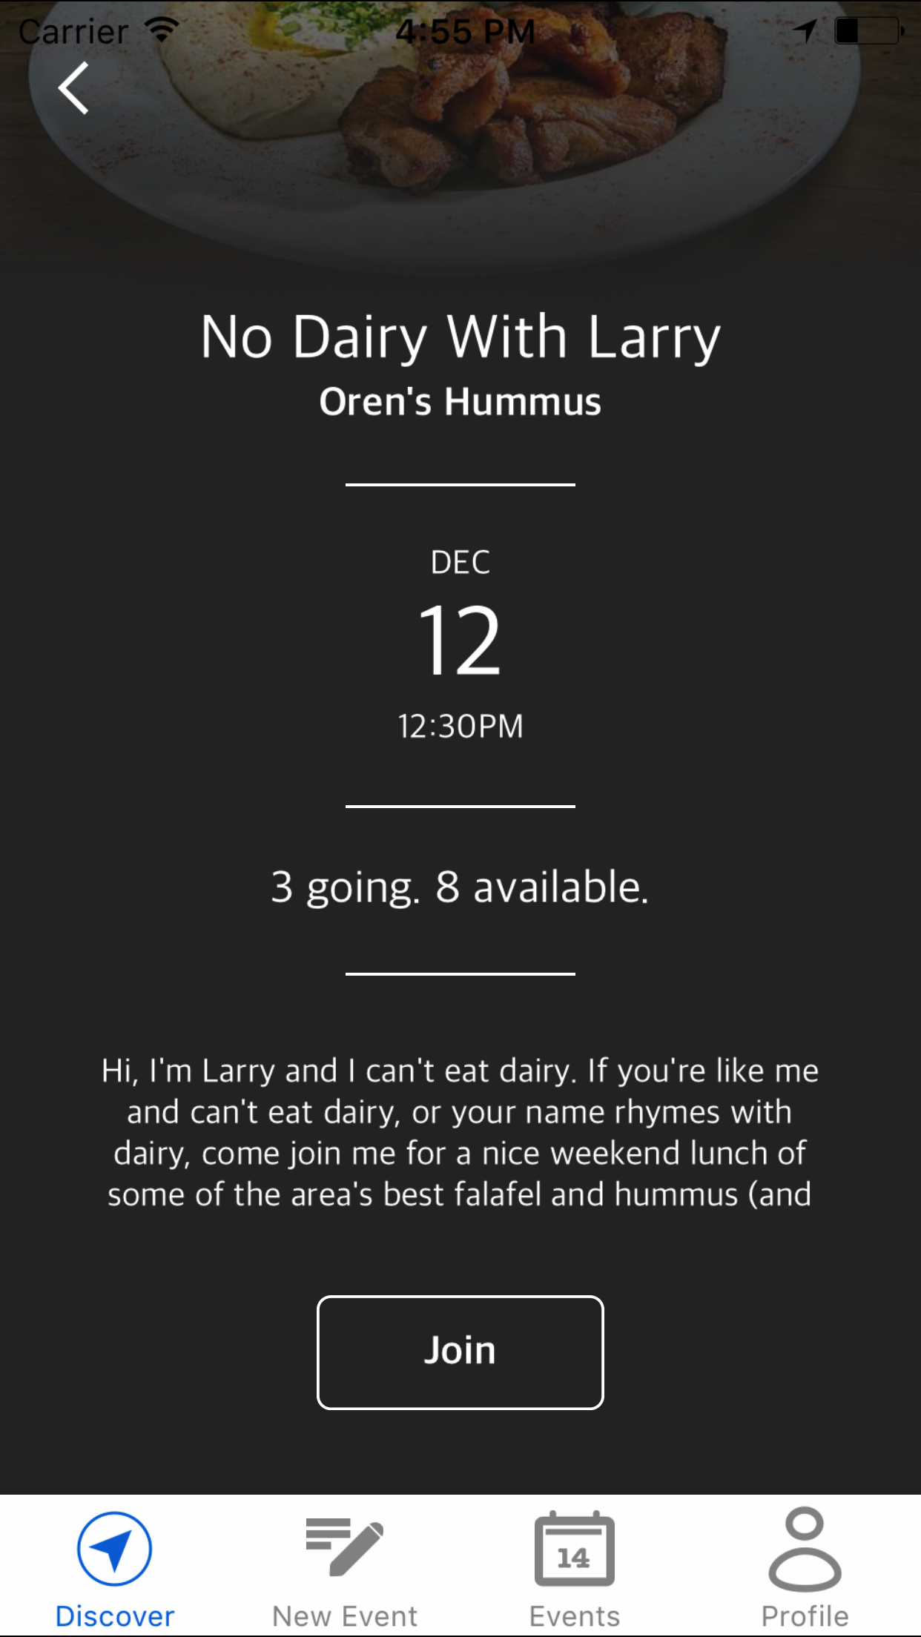
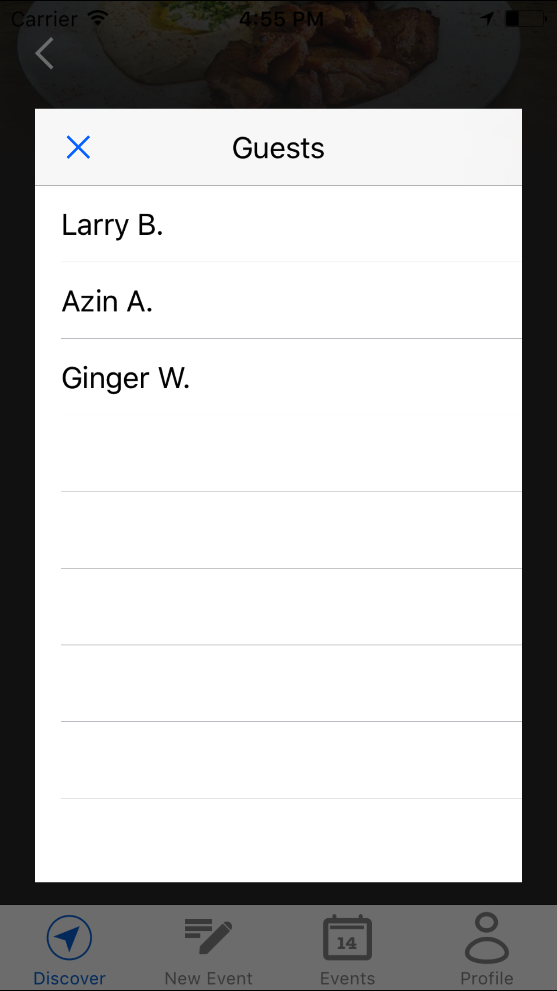
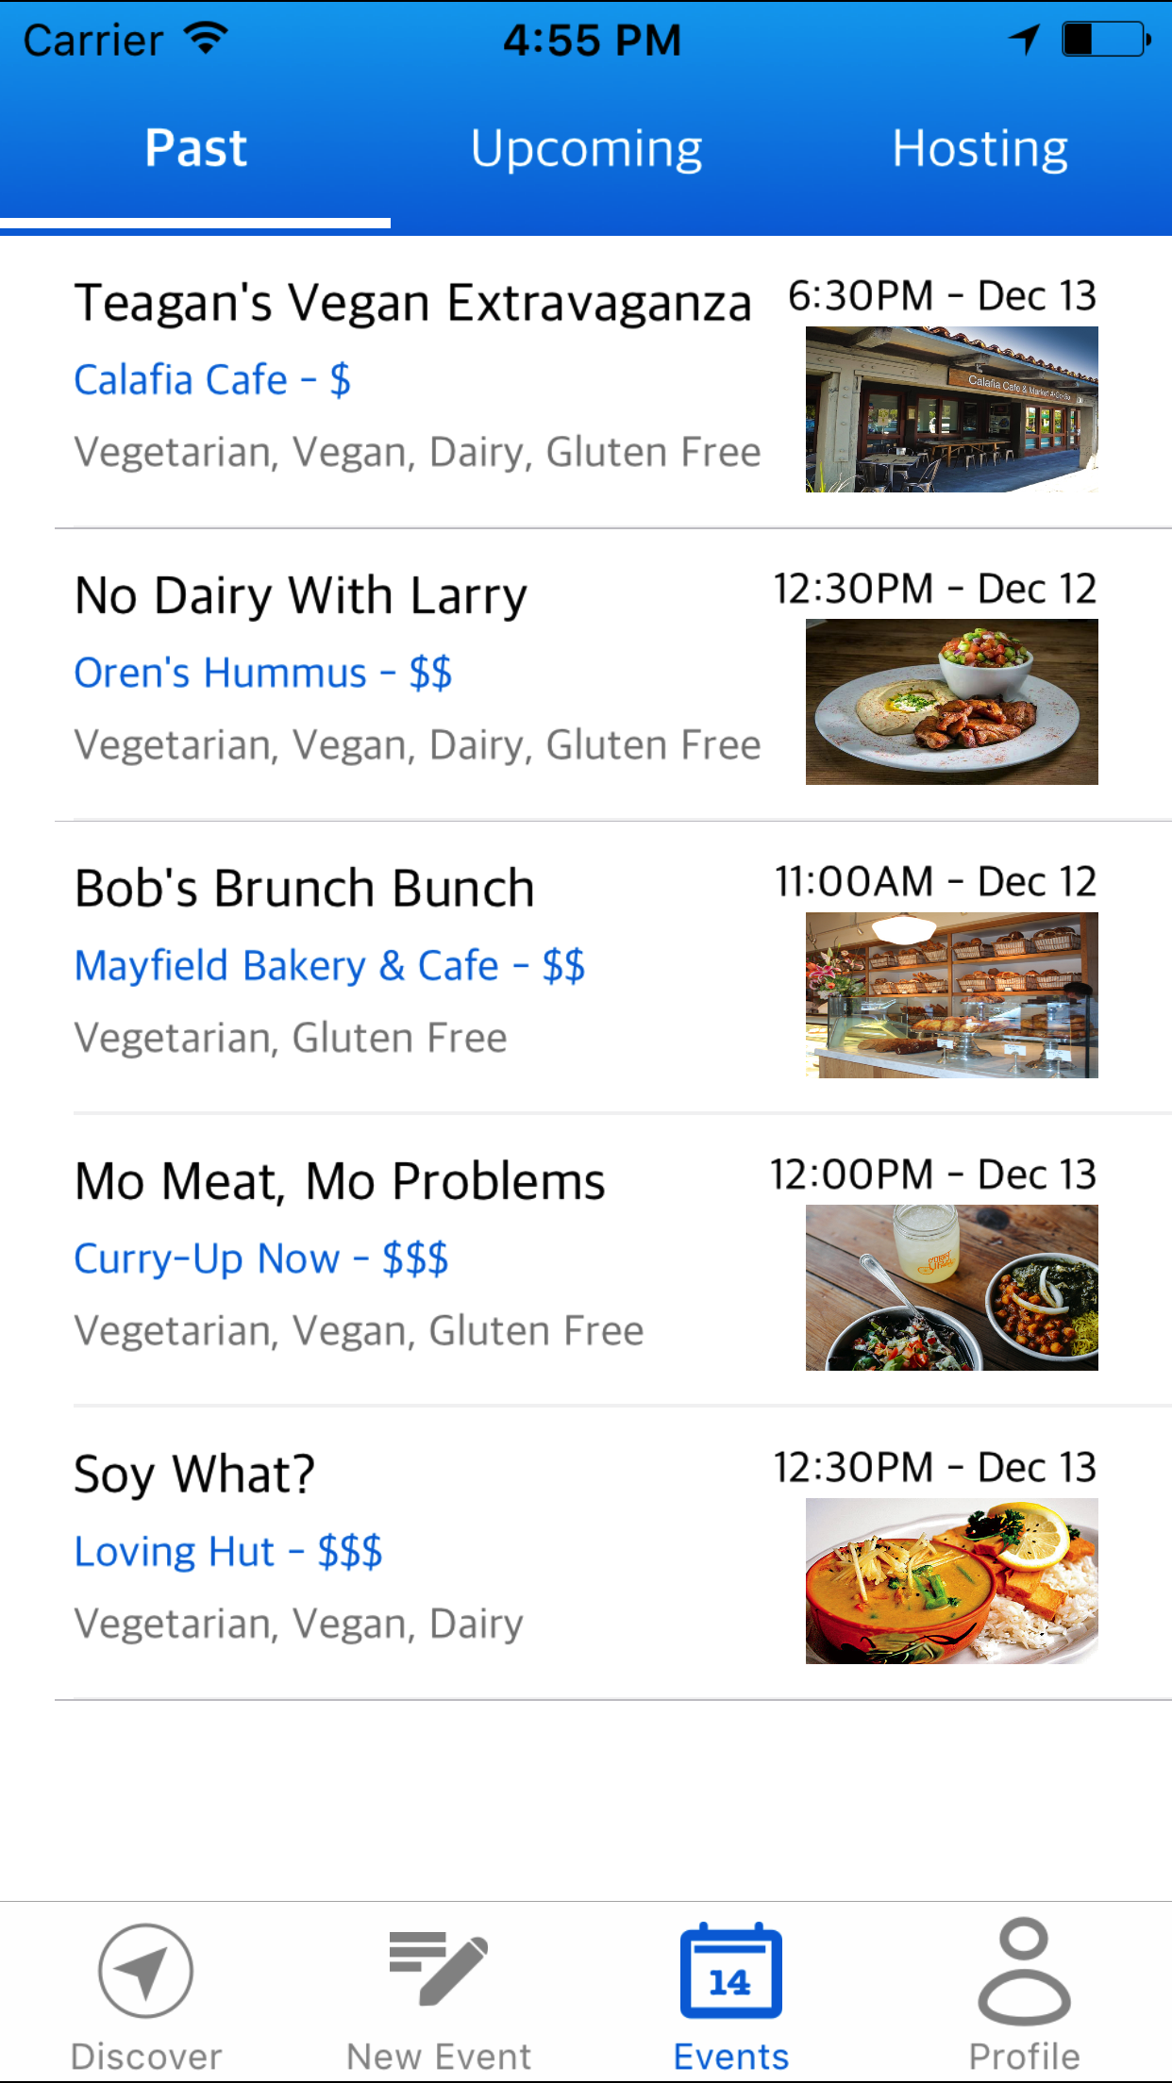
Task 2: Join Events
Attend food centered events hosted by people like you!
Notes:
Social eating is not very social without other PEOPLE! meetchewthere does more than just help users find restaurants. meetchewthere allows users to search a list of nearby restaurant based events hosted by other meetchewthere users that cater to their dietary needs. Alternatively, if a user has a specific restaurant in mind, he/she can use the restaurant search feature to view that restaurant’s details and see a list of its upcoming events. Users simply reserve their spot for the posted events they would like to attend, show up, and meet new people or see old friends!
Filters
Details about event
See guests
Join event

Slide 16
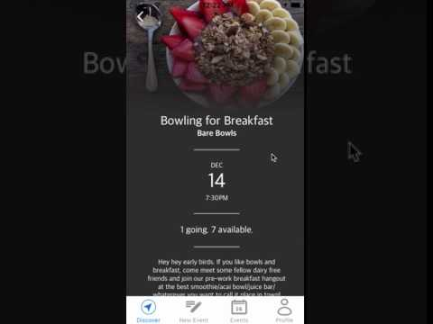
Task 2 Demo

Slide 17
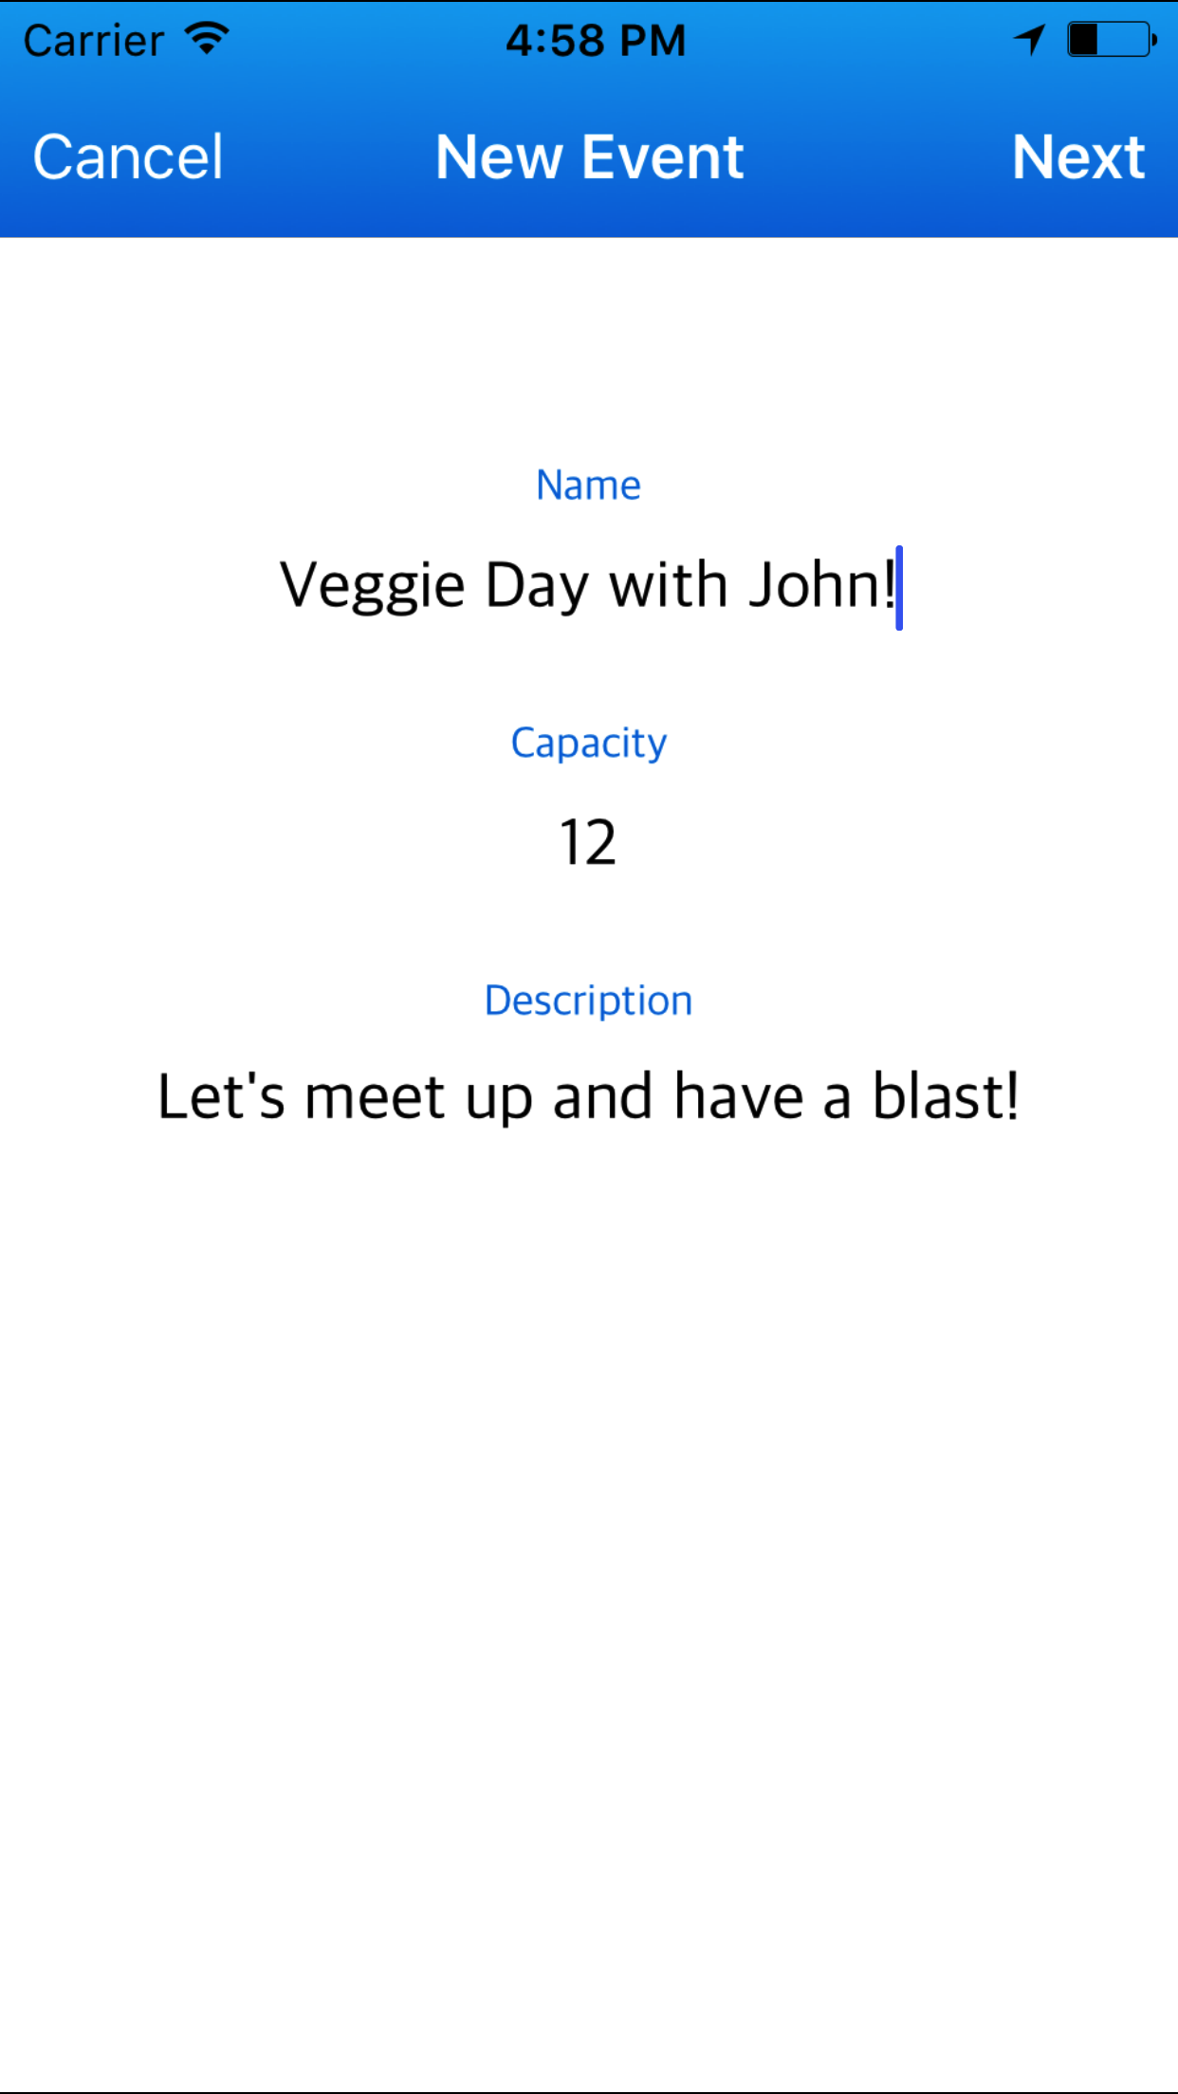
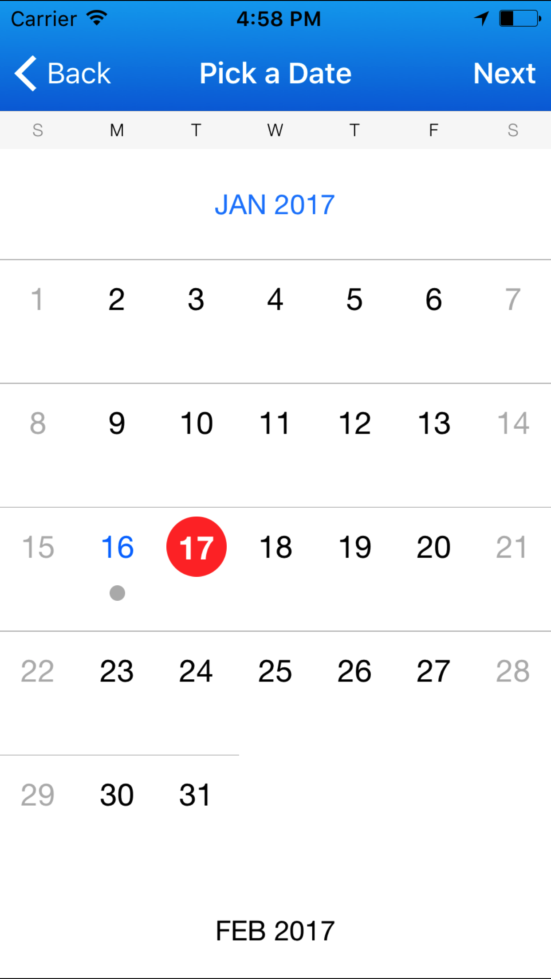
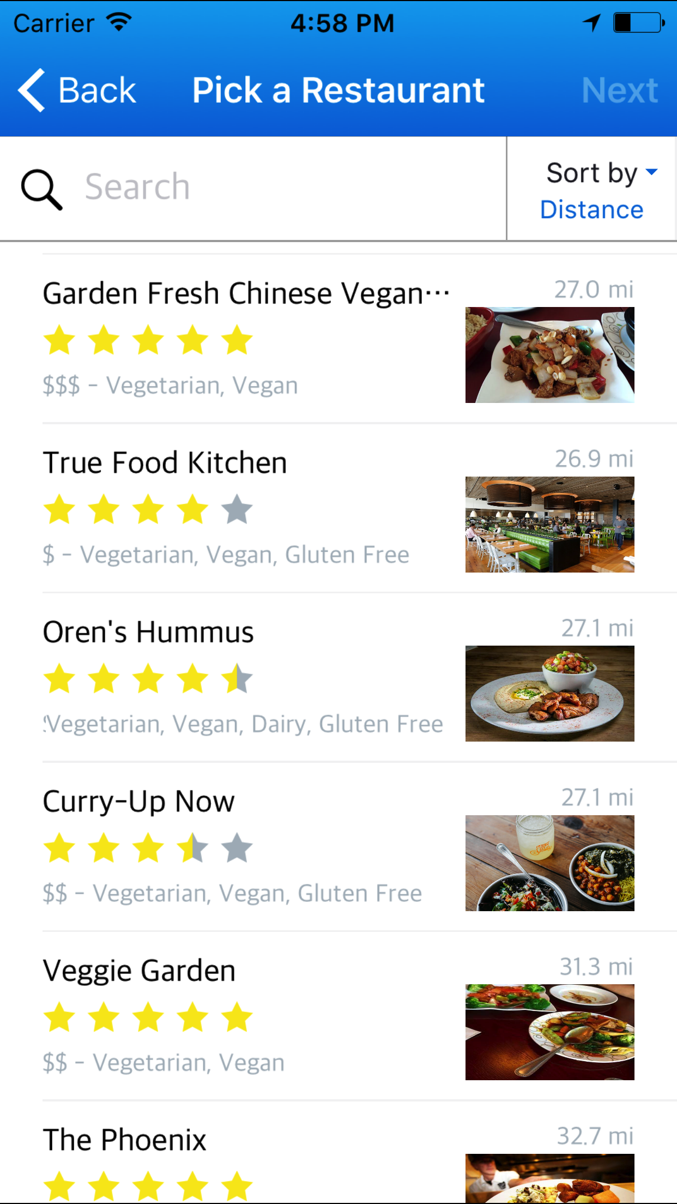
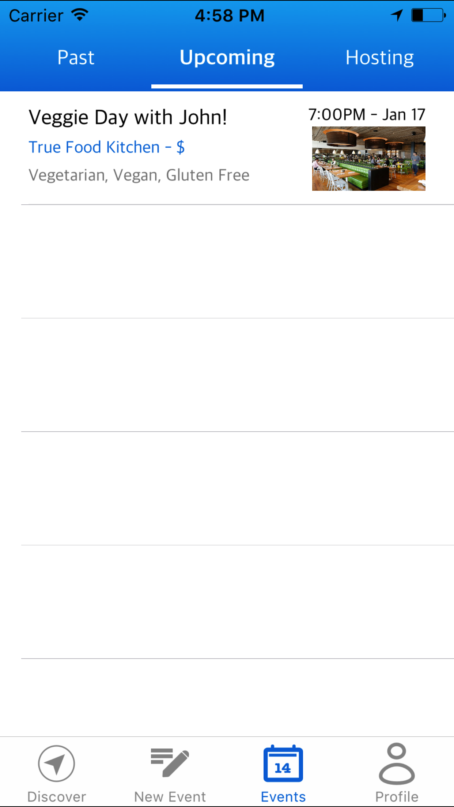
Task 3: Create Events
Create and host events for people who share your dietary needs!
Notes:
Finally, the meetchewthere experience goes beyond finding restaurants and events; each user can take control and build their own community. To support this alternative, we provide users with easy event management and creation tools. Just as users can attend events, users can create and host their own restaurant based event for other meetchewthere users. Users simply give the time and description for their event, the name of the restaurant, the number of available guest spots, and their event is posted for the meetchewthere community. This feature also includes an events management platform to view upcoming events and retrieve information from past events, such as the name of the restaurant and the guests who were in attendance.

Slide 18
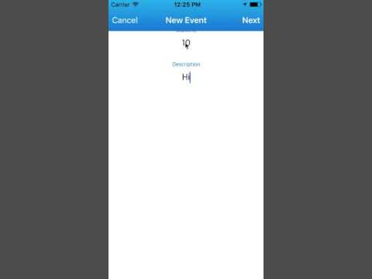
Task 3 Demo

Slide 19
We know it’s not perfect …..

Slide 20
So, whats missing?
Menu in the restaurants page
Ability to invite friends to events
More customization for events and user profile
User interaction and engagement
Notes:
Possibly find a way to which dishes fall under which dietary restriction
Build trust, this can be done by inviting friends
Customise events by adding your own pictures
Need to add profile page where user can control settings
Implement chat functionality for events page where they can ask questions and know more about the event. This would help them to maintain relationships and create new ones.

Slide 21
There’s still a lot on our plate
Build a backend server
Pull restaurant data using Yelp API
Populate user database
Allow event group chats
UI/UX enhancements
Add more profile customization
Host private events (i.e. friends only)
Search with filters

Slide 22
Summary
People limited by dietary restrictions and they need help
Created a platform to help these people eat and meet
Current app features finding restaurants, joining events & hosting events
Need to add more features and improve user experience through field testing

Slide 23
Questions?

